Slide 1
Big Data Analysis on AWS
2018-04-10
By
Christopher Brossman

Slide 2
What are we doing?
Goal
Practice with big data tools in AWS
Predict flight cancellations based on weather patterns and seasonal variation
Reference
https://aws.amazon.com/blogs/big-data/powering-amazon-redshift-analytics-with-apache-spark-and-amazon-machine-learning/
Steps
Ingest data sets & manually load in s3 (usually an API is a good way to dump these)
Below are the two data sources used
https://www.faa.gov/data_research/aviation_data_statistics/data_downloads
https://www.ncdc.noaa.gov/cdo-web/datasets
Spin up EMR & Reshift clusters and setup roles
Connect to EMR through SSH tunnel and run Hive scripts
connect and run Hive scripts – just to see hive in action
Alternative is to dump these to s3 or read directly into Spark, but we are learning Hive!
Connect to redshift through SQL client and run…
create table and load data
load UDF & explain
unload to s3
Run Spark Jobs and output to s3
Read hive dataset (or directly from s3) and s3 and join together
create simple predictor on probability for flight to be delayed
load id and probability into s3
upload script EMR and spark-submit

Slide 3
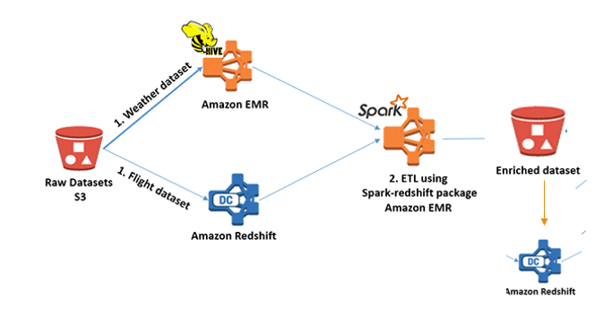
Architecture

Slide 4
S3 file structure

Slide 5
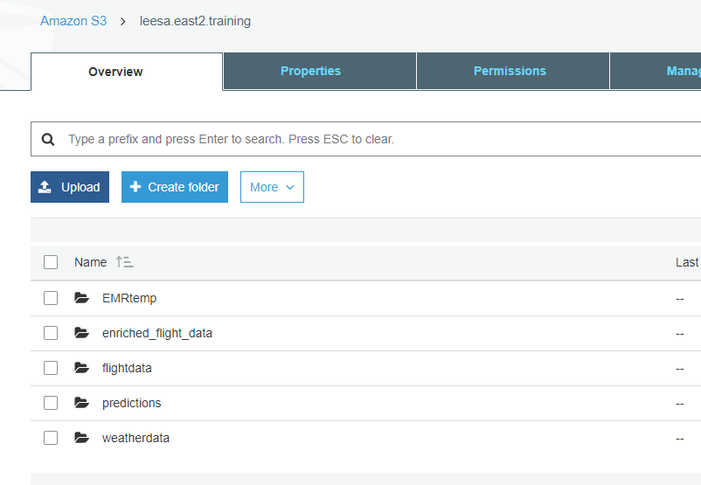
S3 Files Structure

Slide 6
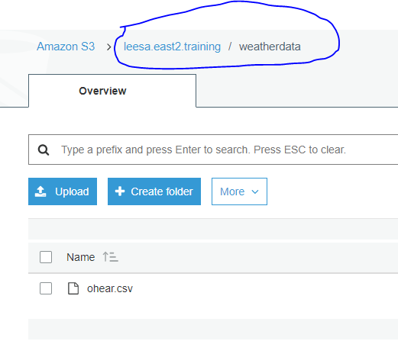
S3 Files Structure

Slide 7
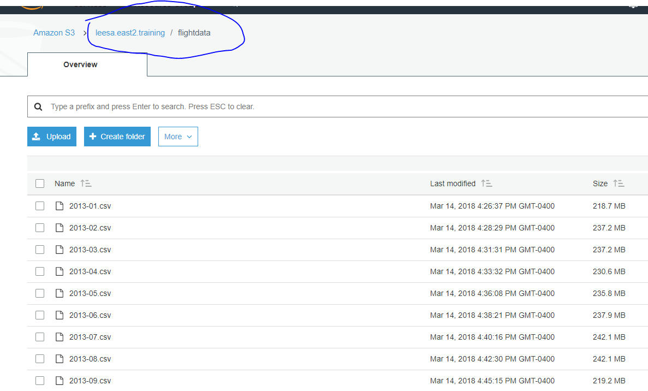
S3 Files Structure

Slide 8
Spin up Clusters
Redshift & EMR

Slide 9
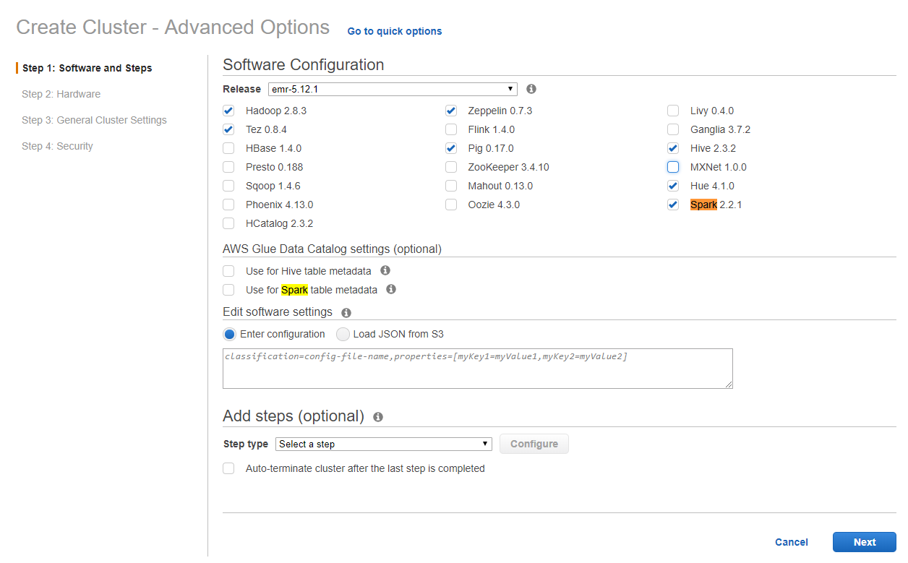
Spin up EMR with Spark & Hive

Slide 10
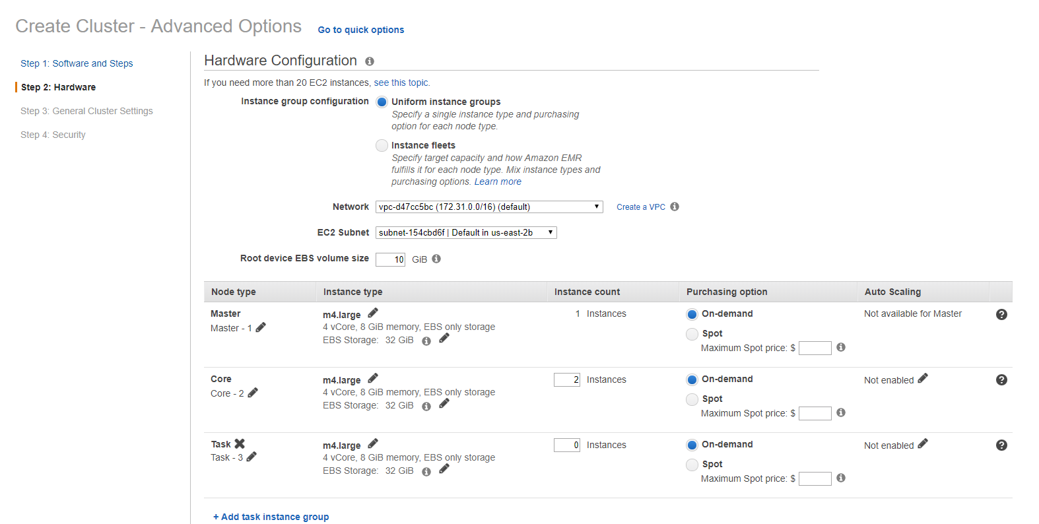
Spin up EMR with Spark & Hive

Slide 11
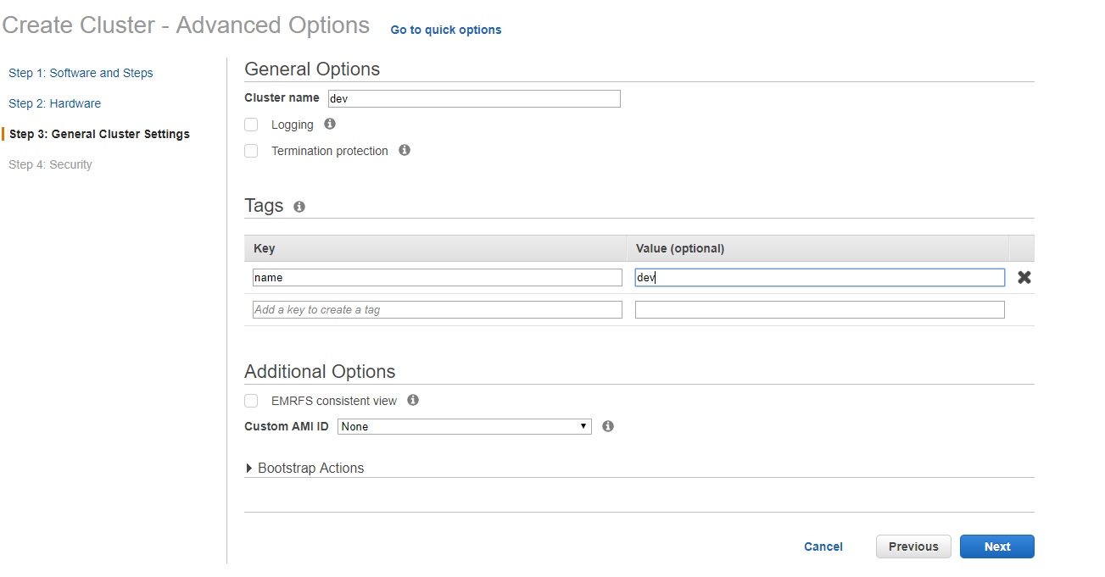
Spin up EMR with Spark & Hive

Slide 12
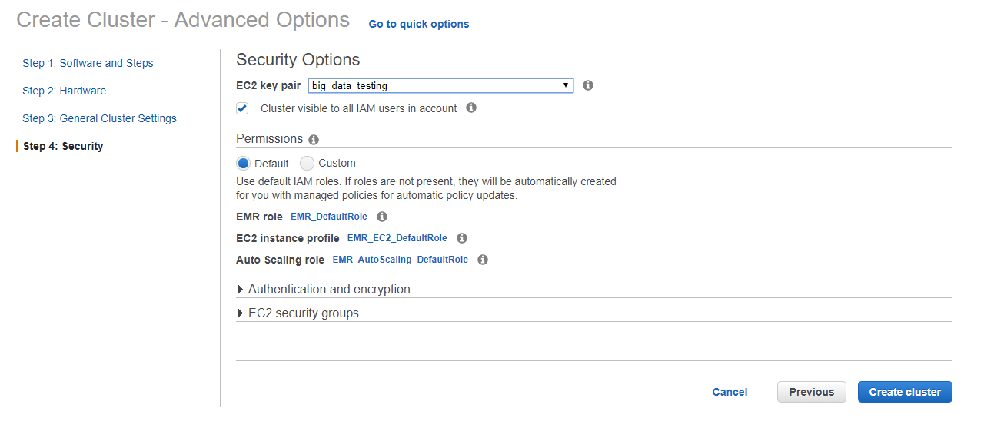
Spin up EMR with Spark & Hive

Slide 13
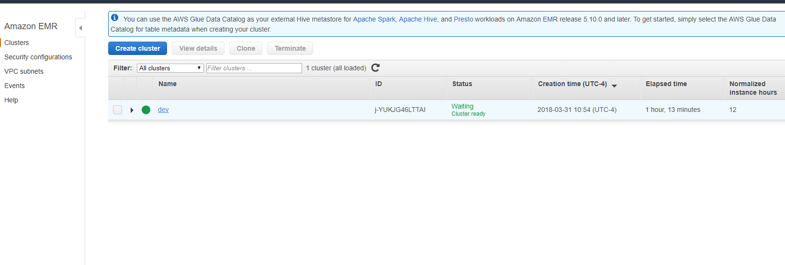
Adjust Security of EMR

Slide 14
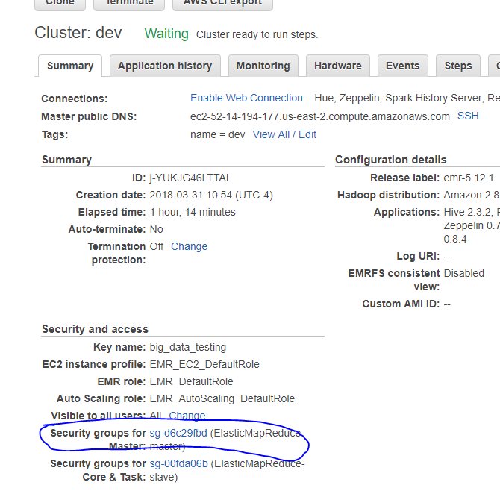
Adjust Security of EMR

Slide 15
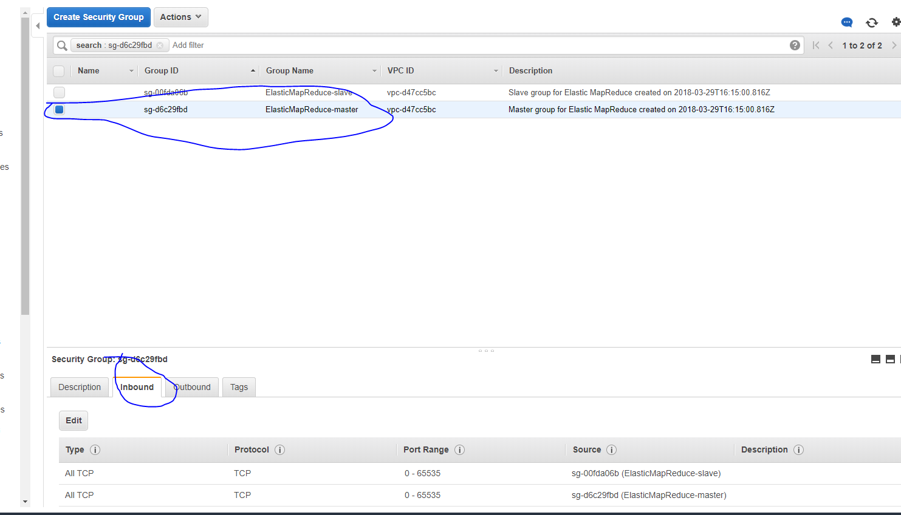
Adjust Security of EMR

Slide 16
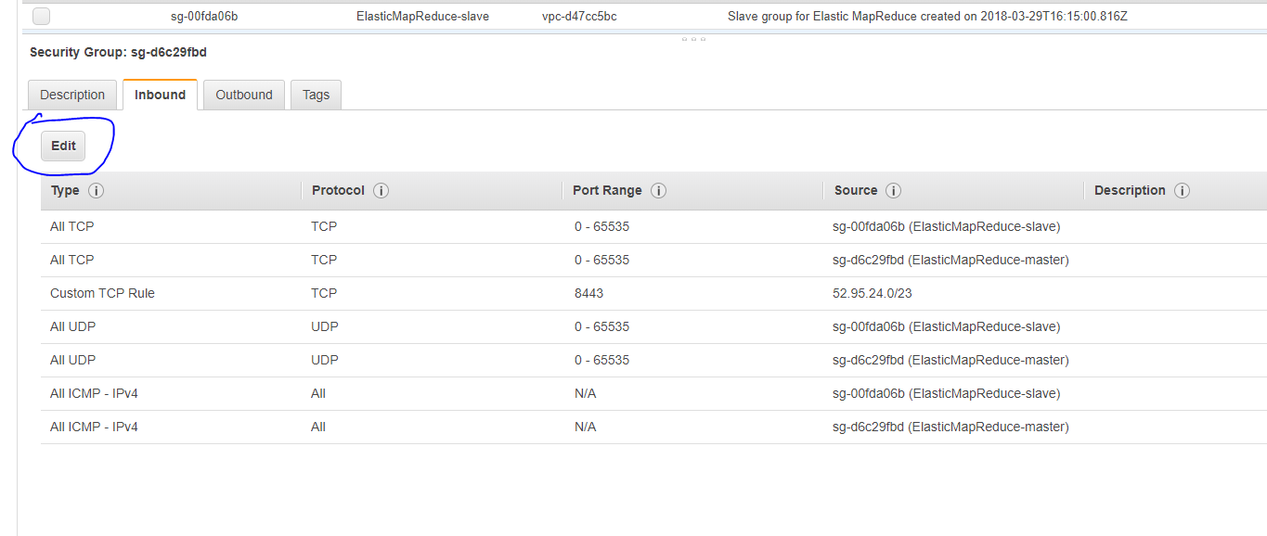
Adjust Security of EMR

Slide 17
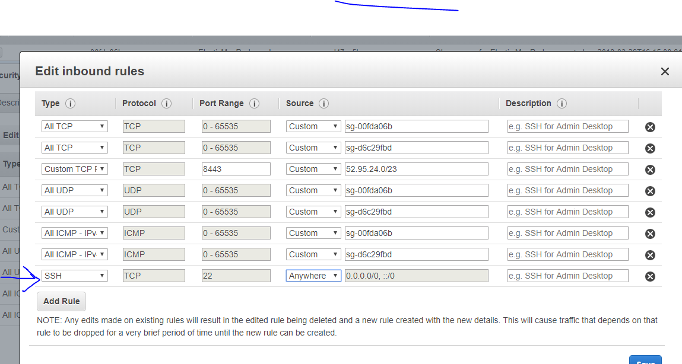
Adjust Security of EMR

Slide 18
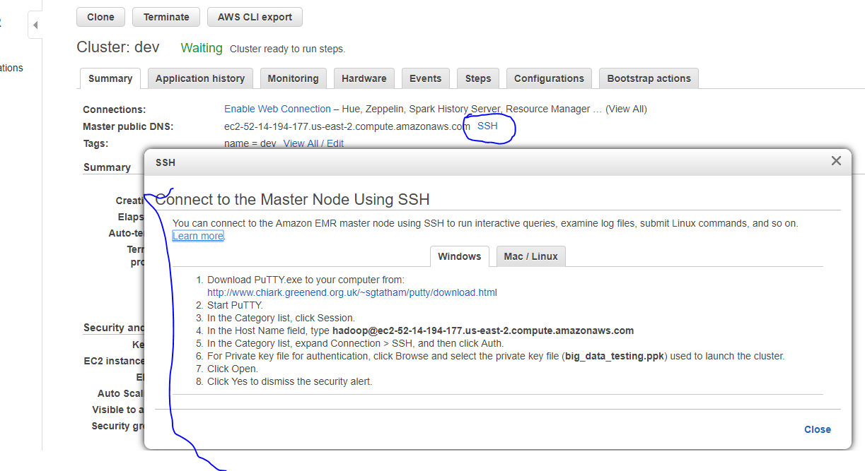
Connect to EMR

Slide 19
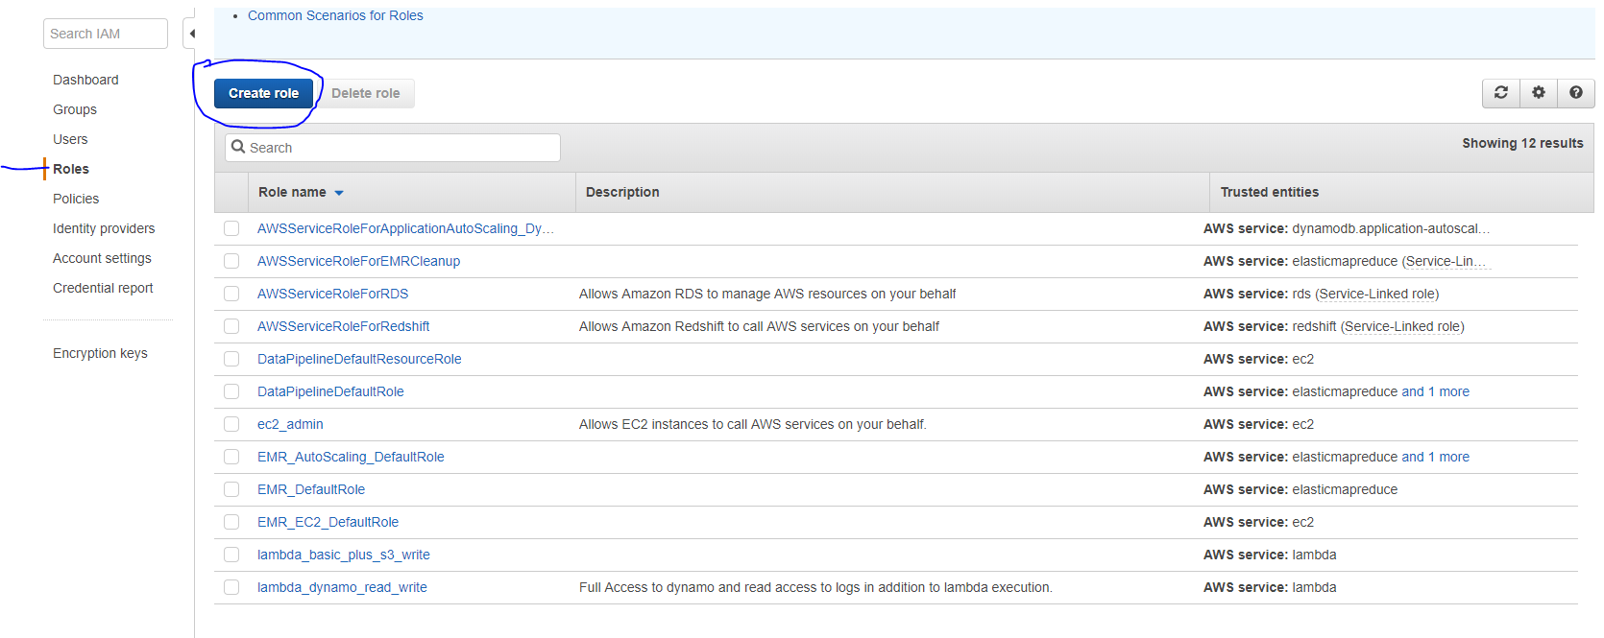
Redshift IAM role

Slide 20
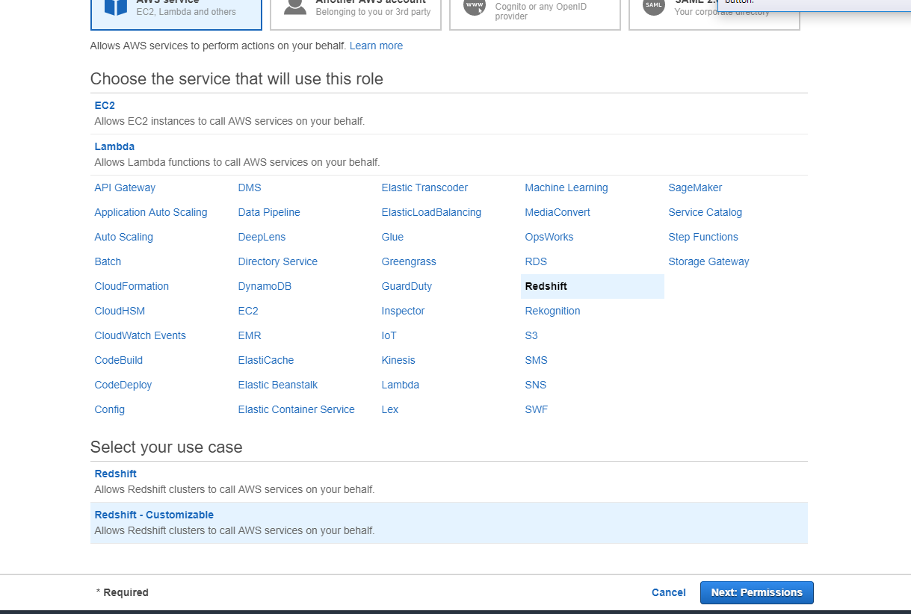
Redshift IAM role

Slide 21
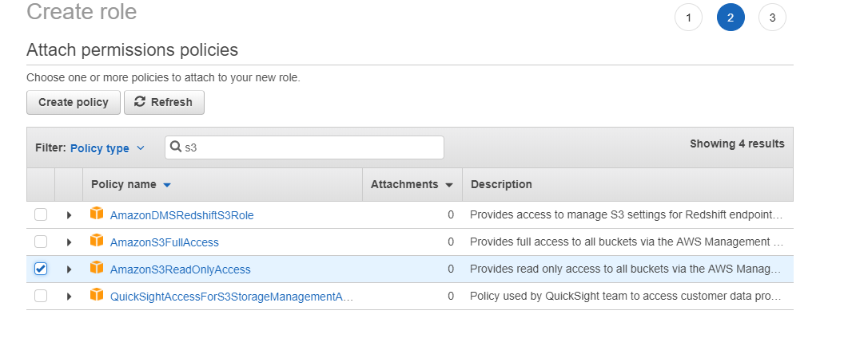
Redshift IAM role

Slide 22
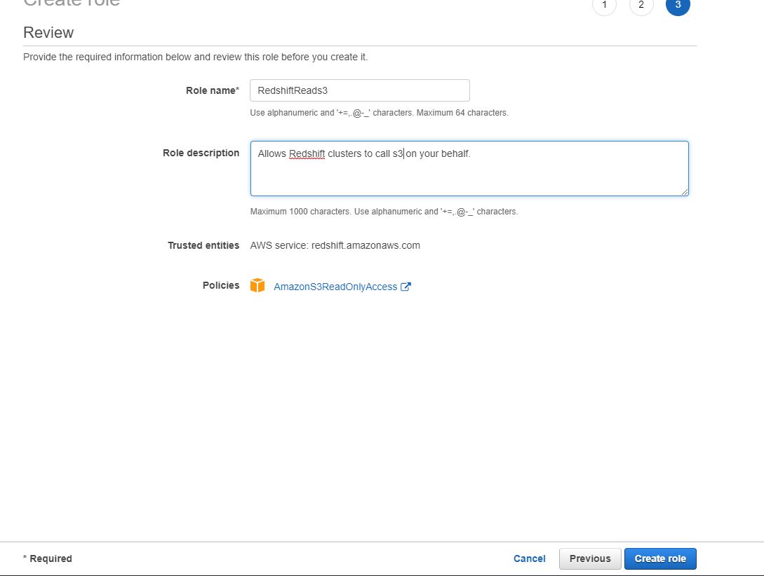
Redshift IAM role

Slide 23
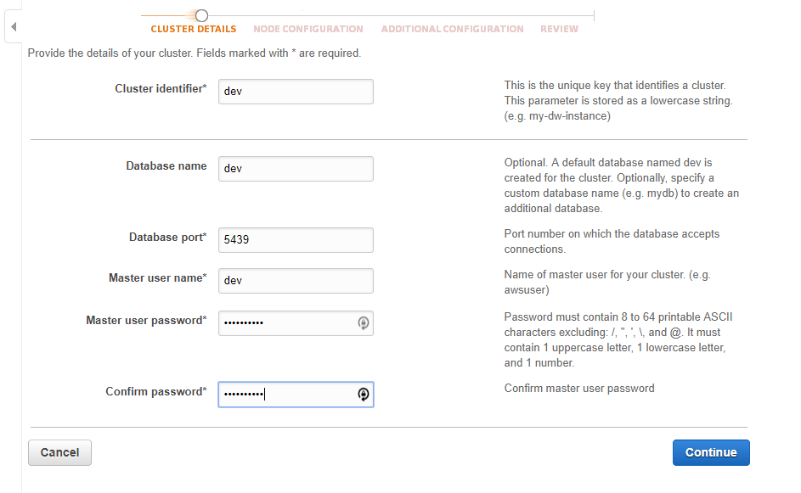
Spin up Redshift

Slide 24
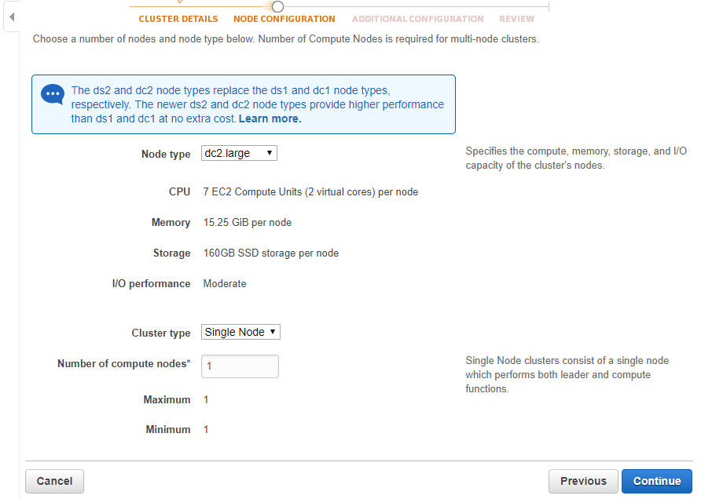
Spin up Redshift

Slide 25
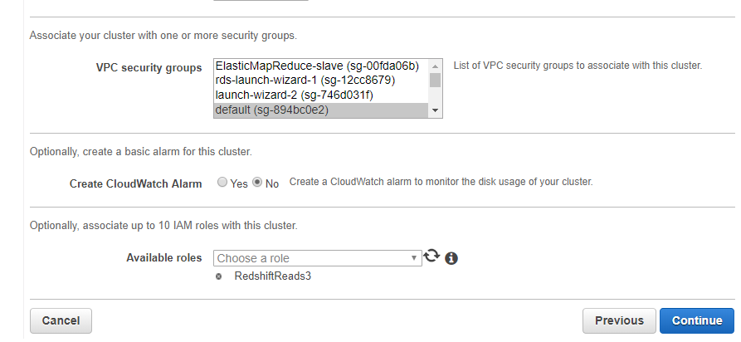
Spin up Redshift

Slide 26
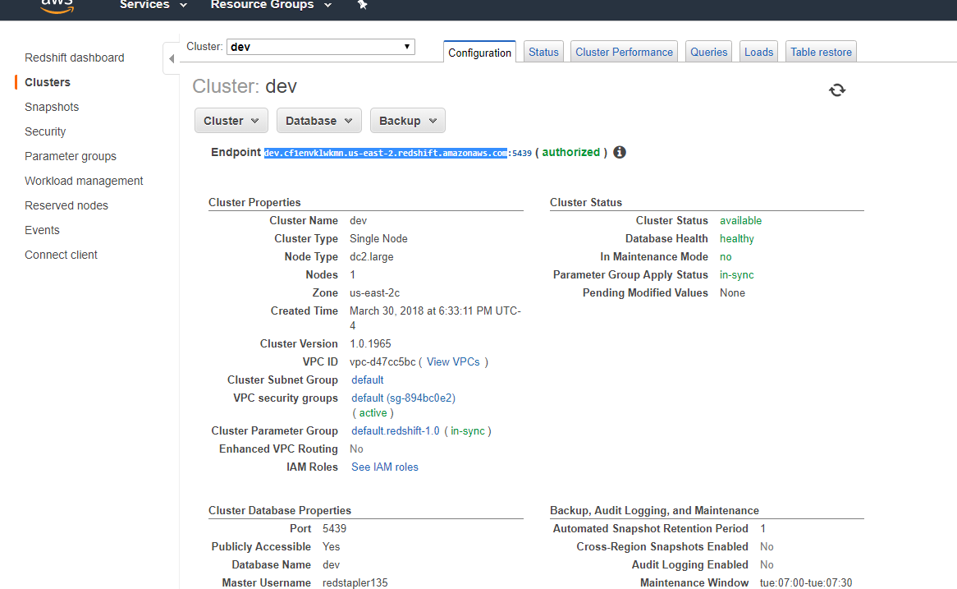
Connect to Redshift

Slide 27
Run Hive Scripts

Slide 28
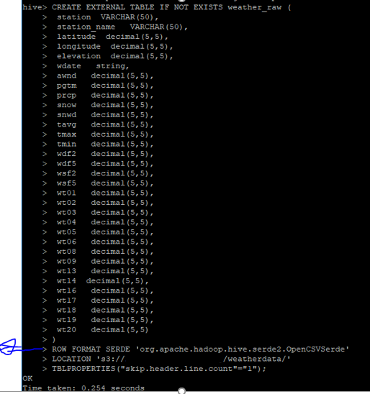
Run Hive Scripts

Slide 29
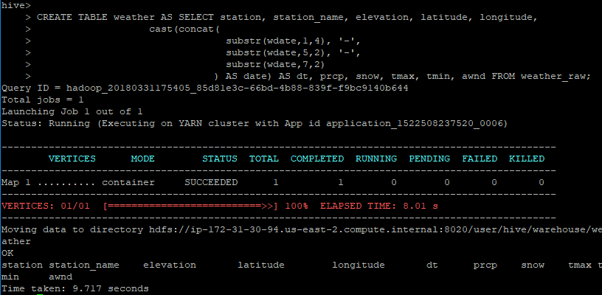
Run Hive Scripts

Slide 30
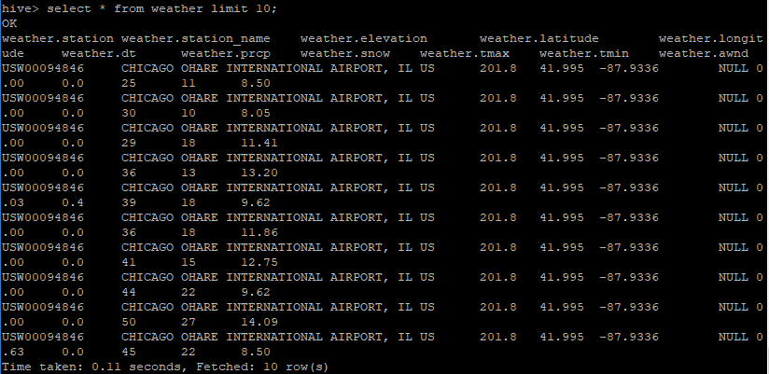
Run Hive Scripts

Slide 31
Redshift Scripts

Slide 32
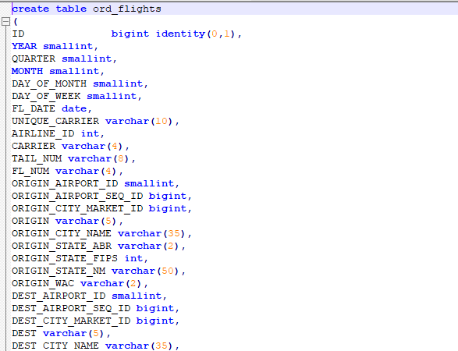
Run Redshift Scripts –create table

Slide 33

Run Redshift Scripts – load data from s3

Slide 34
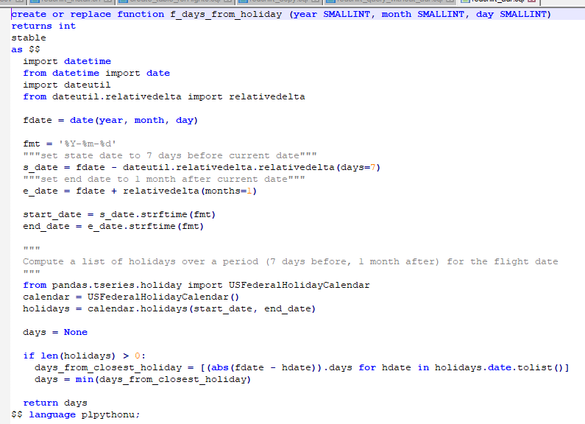
Run Redshift Scripts - UDF

Slide 35
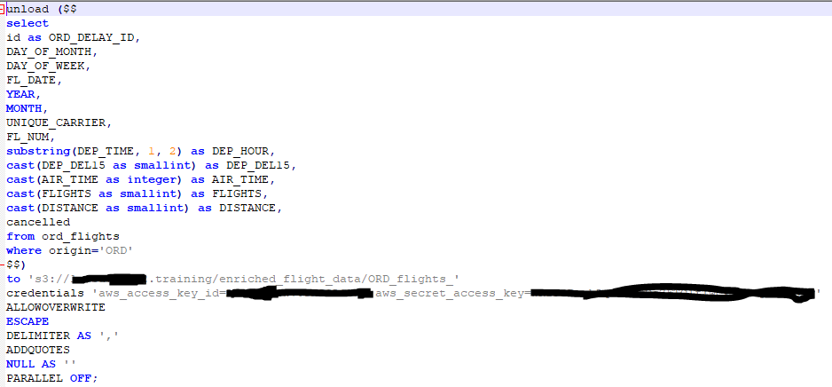
Run Redshift Scripts – unload to s3

Slide 36
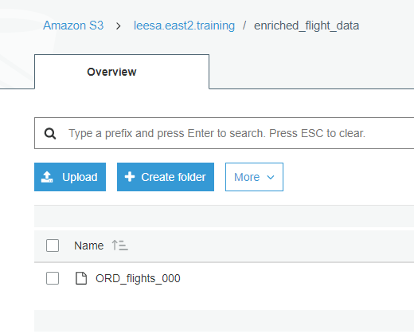
S3 from redshift unload

Slide 37
PySpark

Slide 38
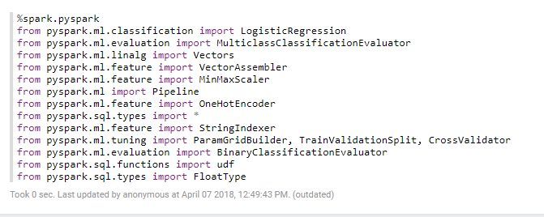
Zeppelin File Imports

Slide 39
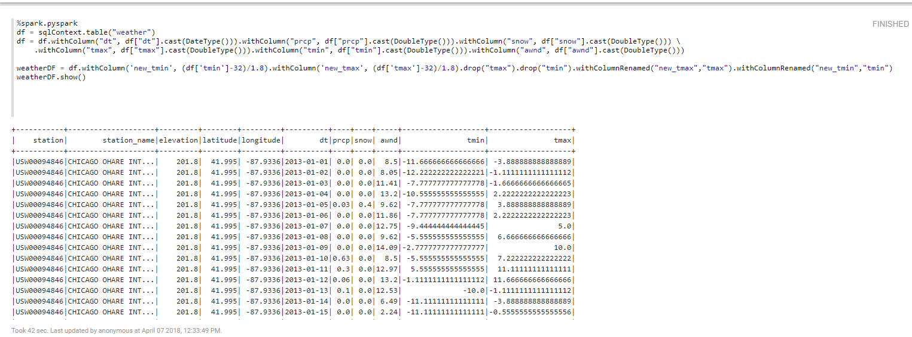
Get Hive Data – on same cluster

Slide 40
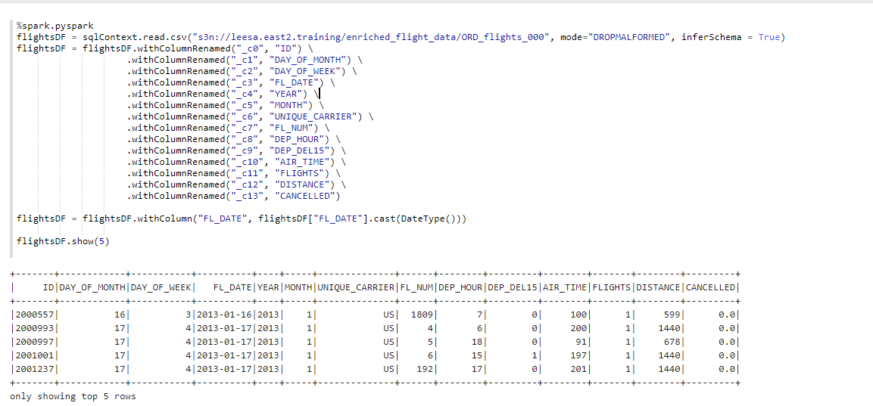
Get Flight Data From s3

Slide 41
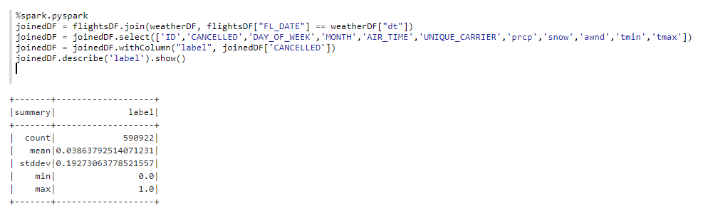
Join Data – give summary stats of variable of interest

Slide 42

Impute null values

Slide 43
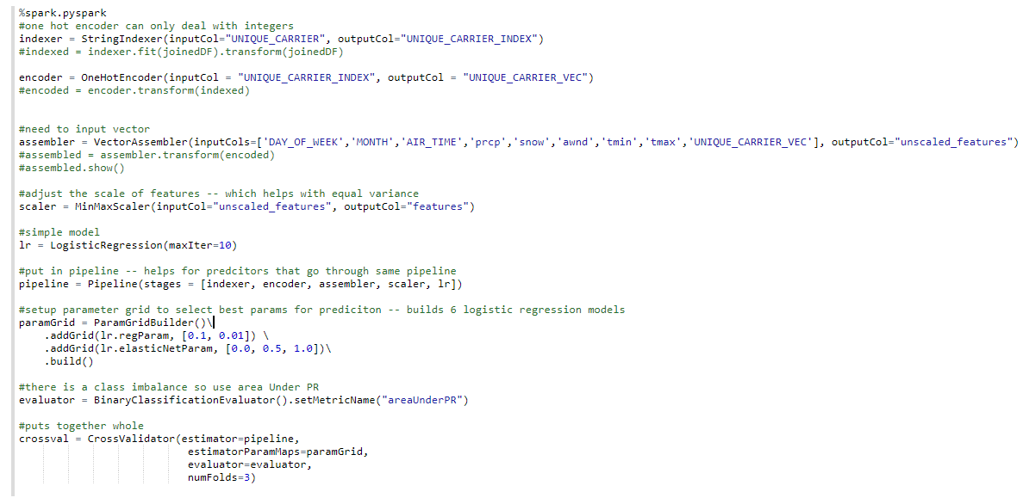
Setup ML Pipeline

Slide 44
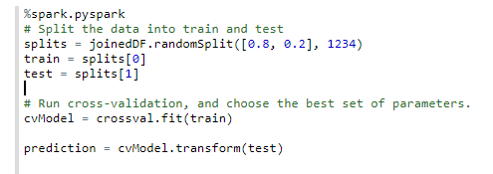
Run ML pipeline

Slide 45

Evaluate ML

Slide 46
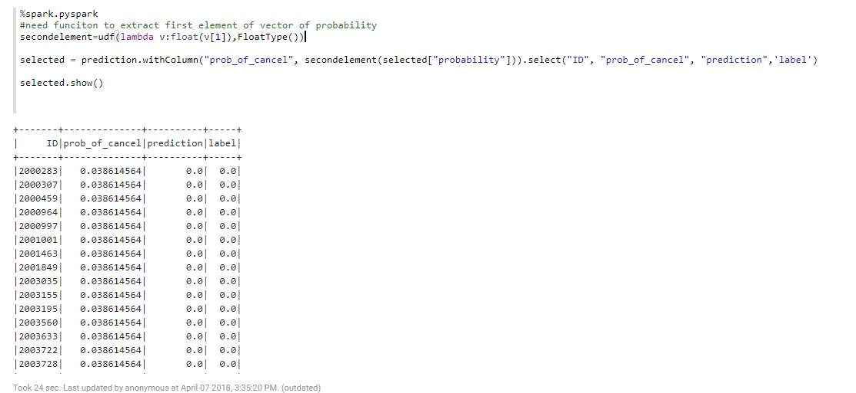
Prep export

Slide 47
Export to S3

Slide 48
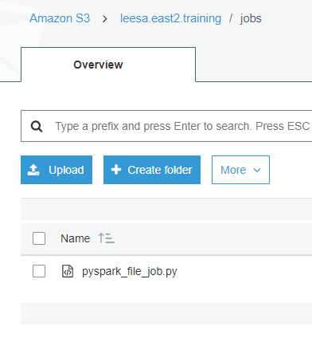
Submit Job -adjust python file for spark job & put on s3

Slide 49
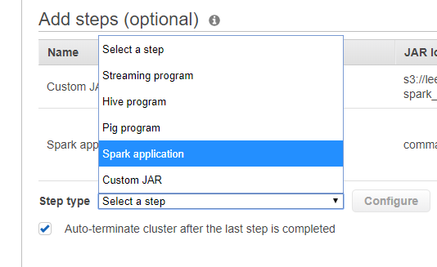
Submit Job -add step in EMR cluster

Slide 50
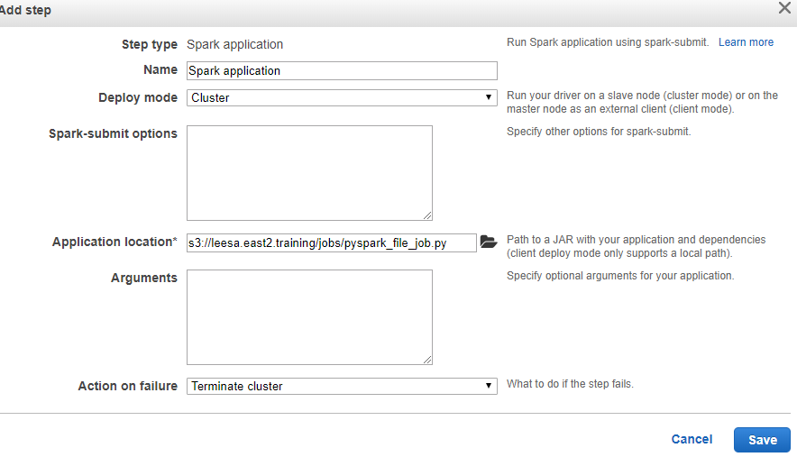
Submit Job -add step in EMR cluster

Slide 51
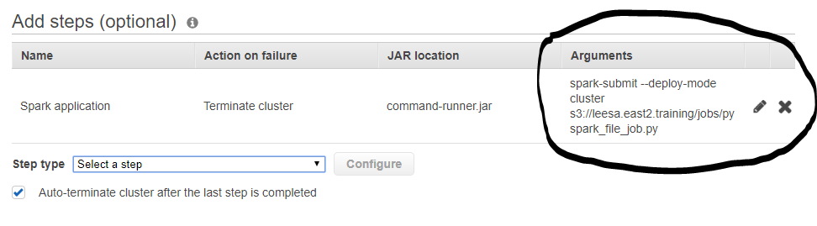
Submit Job -add step in EMR cluster

